Slide 1

Date: | Human Biology Year 12 ATAR
Do Now Do the practice exam question provided Lesson Agenda 1: Do Now 2: The Adrenal Gland Hormones: production, effects and regulation 3: Do the Review Worksheet Provided 4: Lesson summary and wind-up Suggested Study Read through today’s notes and textbook section, especially any flow diagrams showing hormone regulation. Finish the Review Worksheet, and mark and correct your work using the answer key. NEXT LESSON Past Exam Question The Pancreas | Learning Aims Describe the location and structure of the adrenal glands List, and describe the effects of, hormones produced by the adrenal cortex and the adrenal medulla. Describe in detail the regulation and effects of aldosterone Describe in detail the regulation and effects of cortisol Describe in detail the regulation and effects of catecholamine release.
 | Key Vocabulary Catecholamine Mineralocorticoid Glucocorticoid CRH ACTH Cortisol Aldosterone Adrenalin Noradrenalin

Slide 2
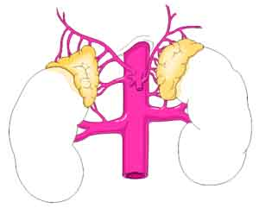
The Adrenal Glands
Structure, Hormones, Regulation and Disease
Ch2 Human Perspectives

Slide 3
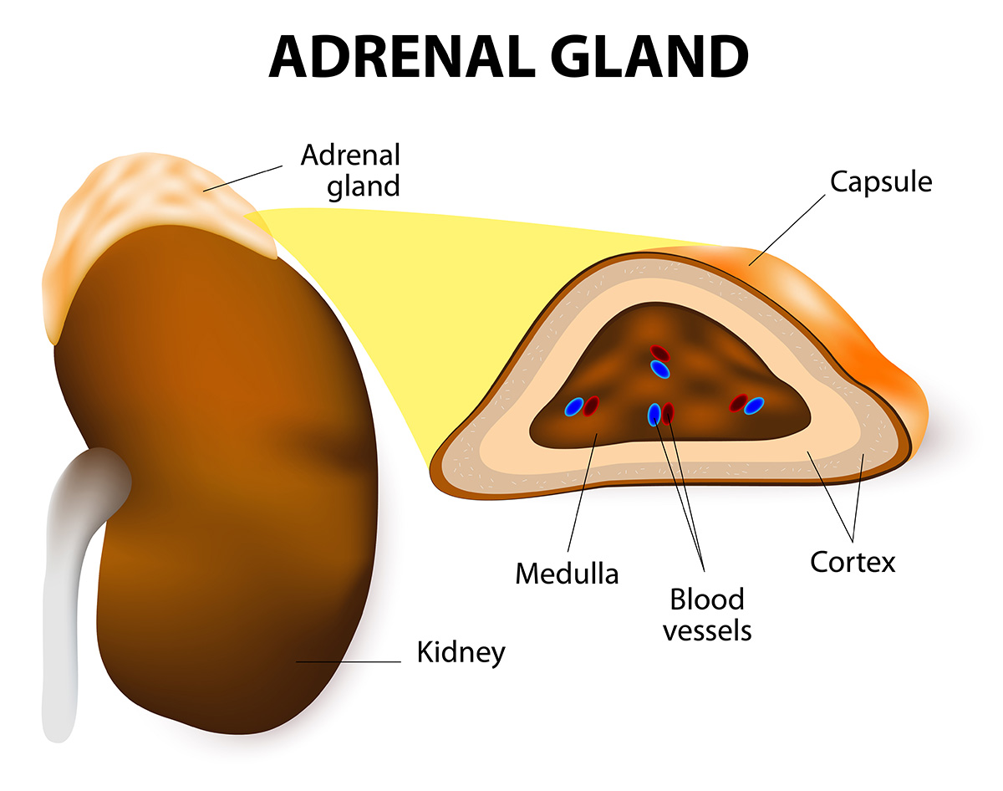
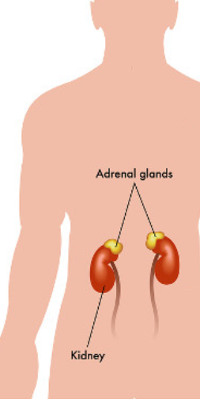
Adrenal Gland Location and Structure
Located on top of each kidney
Cortex – outer layer
Medulla – inner layer
Learning Aim: Describe the location and structure of the adrenal glands

Slide 4
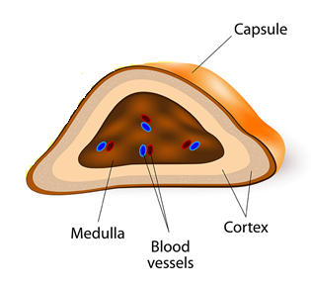
Adrenal Gland Hormones
Adrenal Cortex (outside) | Adrenal Medulla (inside)
Aldosterone: A mineralocorticoid Role in maintaining salt and water levels in body, and therefore blood pressure Acts on collecting ducts in kidney, causing increased Na⁺ and water reabsorption and increased K⁺ secretion. | Catecholamines eg: Adrenaline, Noradrenaline, and some Dopamine Involved in response to acute stress – “fight or flight. Increase blood pressure, heart rate, respiratory function. Direct blood away from digestive tract
Cortisol: A glucocorticoid Role in response to stress, illness and metabolism Stimulates glucose production via gluconeogenesis and conversion of glycogen to glucose. Also has potent anti-inflammatory effects
Adrenal Androgens Weak effects Involved in male sex organ development in childhood
Learning Aim: List, and describe the effects of hormones produced by the adrenal cortex and the adrenal medulla.

Slide 5
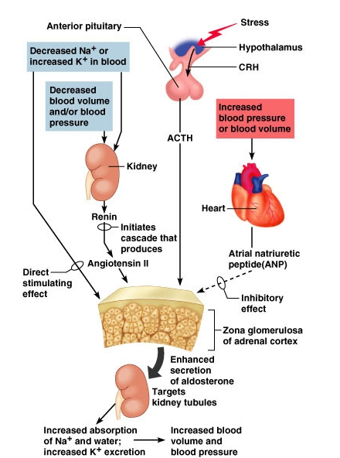
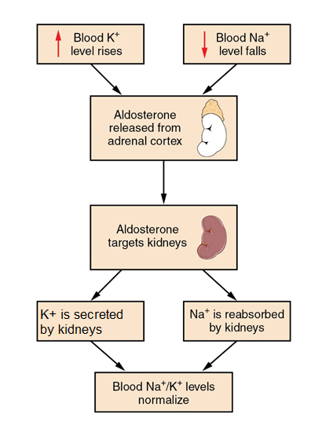
Regulation of Aldosterone release
It’s complicated!
For Year 12 ATAR Human Biology, focus on:
Aldosterone:
Mineralocorticoid
Role in maintaining salt and water levels in body, and therefore blood pressure.
Reliant on signalling from receptors in kidney and heart.
Acts on collecting ducts in kidney, causing increased Na⁺ and water reabsorption and increased K⁺ secretion.
Learning Aim: Describe in detail the regulation and effects of aldosterone.

Slide 6
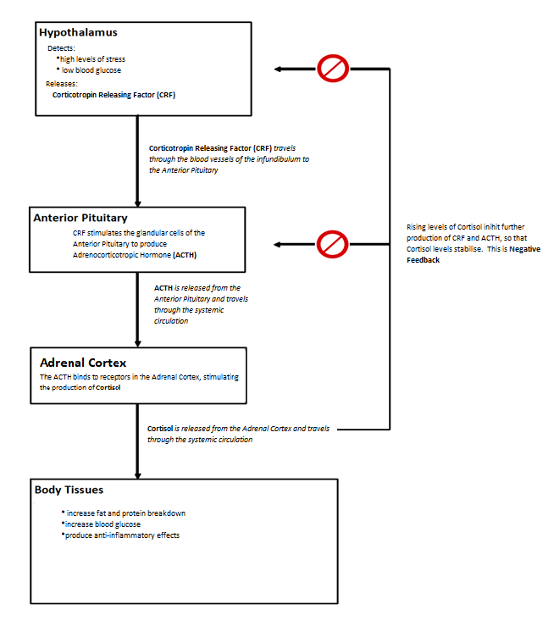
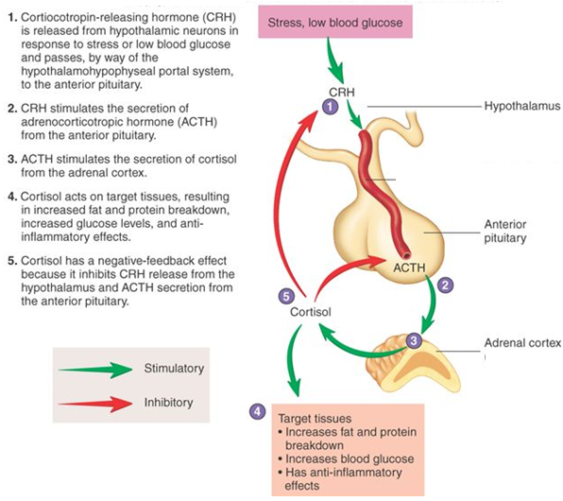
Regulation of Cortisol Secretion
Learning Aim: Describe in detail the regulation and effects of cortisol.

Slide 7
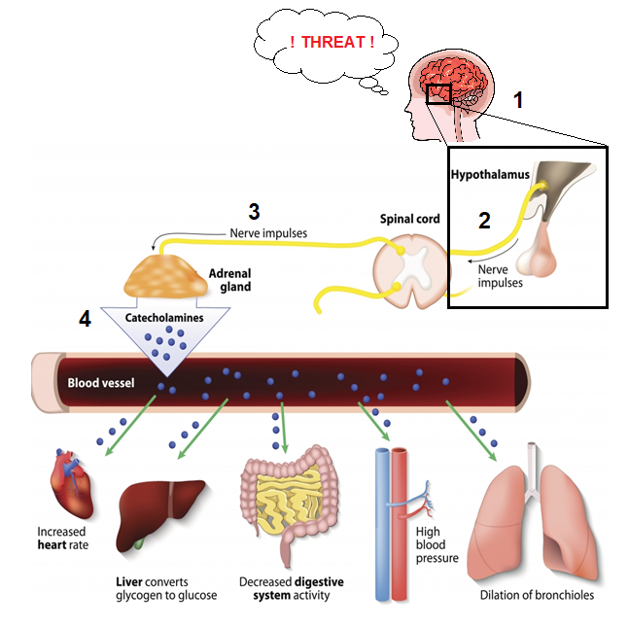
Regulation of Catecholamine release
Interaction between nervous system and endocrine system.
1: Brain detects threat, and sends nerve signals to the hypothalamus
2: The hypothalamus sends nerve signals to the spinal cord (via the autonomic nervous system)
3: The spinal cord sends signals to the adrenal medulla
4: The adrenal gland produces catecholamines such as adrenalin and noradrenalin, producing a “fight or flight” response:
Increased heart rate and blood pressure
Dilation of bronchioles
Liver converts glycogen to glucose, increasing blood glucose
Digestive system activity decreases
5: When the threat stimulus is no longer detected, the hypothalamus will stop sending nerve impulses to the adrenal medulla.
Learning Aim: Describe in detail the regulation and effects of catecholamine release.

Slide 8
Disorders of the Adrenal Gland
Are complex in symptoms, diagnosis and treatment
Are not a focus in the curriculum

